Slide 1
PYRAMIDS
Technology Corp.
CREATIVITY ‧ PRODUCTIVITY ‧ PRATICALITY

Slide 2
Pyramids Technology Corp.
HISTORY
Our Journey of Evolution
1995
1998
2002
2015
2022
2023
The year Pyramids Technology is established
Pyramids started to provide injection molding and tool development service
Establish the first assembly line
Head quarters (Current Location) established
Cleanroom Plastic and LSR molding shop established
Warehouse expansion completed
| 01
Copyright ©2024 Pyramids Technology Corp. All rights reserved

Slide 3
Pyramids Technology Corp – Organization Charts
General Manager
Eric Young
Sales Dept.
David Wu, VP
Financial &
Administrative Dept.
Eric Young, G.M
Research &
Development Dept.
Tony Cheng, VP
Manufacturing Dept.
Eric Young, G.M
Quality Control Dept.
Gary Chen, VP
Advanced Molding Dept.
Gary Chen, VP
PPC Plant
Gary Chen, VP
Brian Chiang
Director
Kavin Hsu
Director & IT Manager
R&D Dept.
Aries Chang
Director
QC Dept.
Steven Wang
Director
PPC
Sales Dept.
IT Dept.
Alex Chen
Dept Manager
William Li
Deputy Manager
Jerry Lin
Deputy Manager
MFG Division I
Raymond Wang
Dept Manager
Technology Research
Sam Huang
Dept Manager
Hank Ho
Procurement Manager
Ally Huang
Finance & Adm Manager
Daniel Chueng
Dept Manager
Casper Huang
Deputy Manager
Molding Section
Procurement
Dept.
Finance
Dept.
Connie Kang
Dept Manager
Production Control Dept.
Ryan Huang
MGF D-II Manager
Vicky Wang
Assembly Line Manager
Assembly Control (Assembly line)
MFG Division II
Yen Huang
Warehouse Manager
Inventory Control
(Warehouse)
| 02
Copyright ©2024 Pyramids Technology Corp. All rights reserved

Slide 4
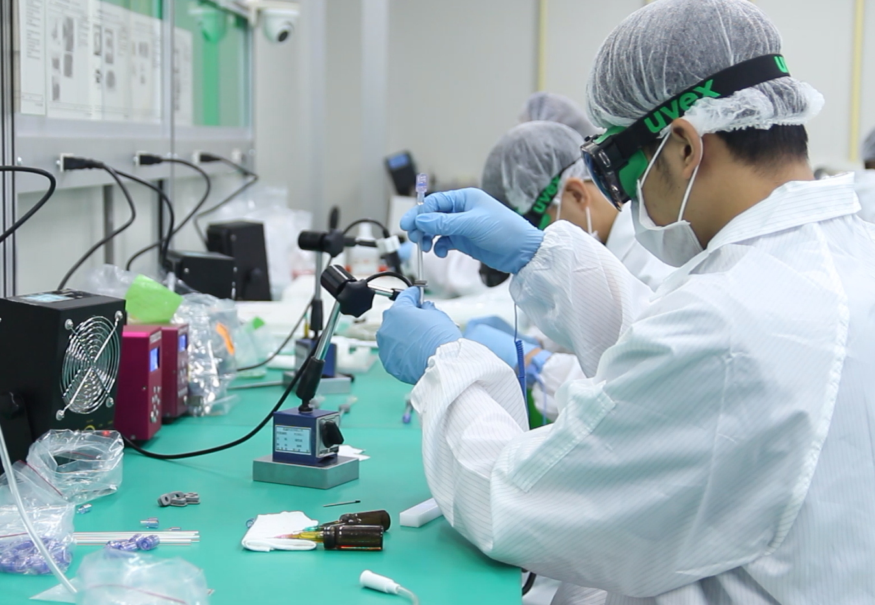
PRODUCTIVITY - Employees Distribution
Administrative Staff: 81 Staffs
Engineering Team: 70 Engineers
Manufacturing Team:
Standard Assembly Facility – 35 lines/ 134 operators
White Room Assembly Facility – 4 lines/15 operators
ISO Level 7 Assembly Facility – 27 lines/60 operators
| 03
Copyright ©2024 Pyramids Technology Corp. All rights reserved

Slide 5
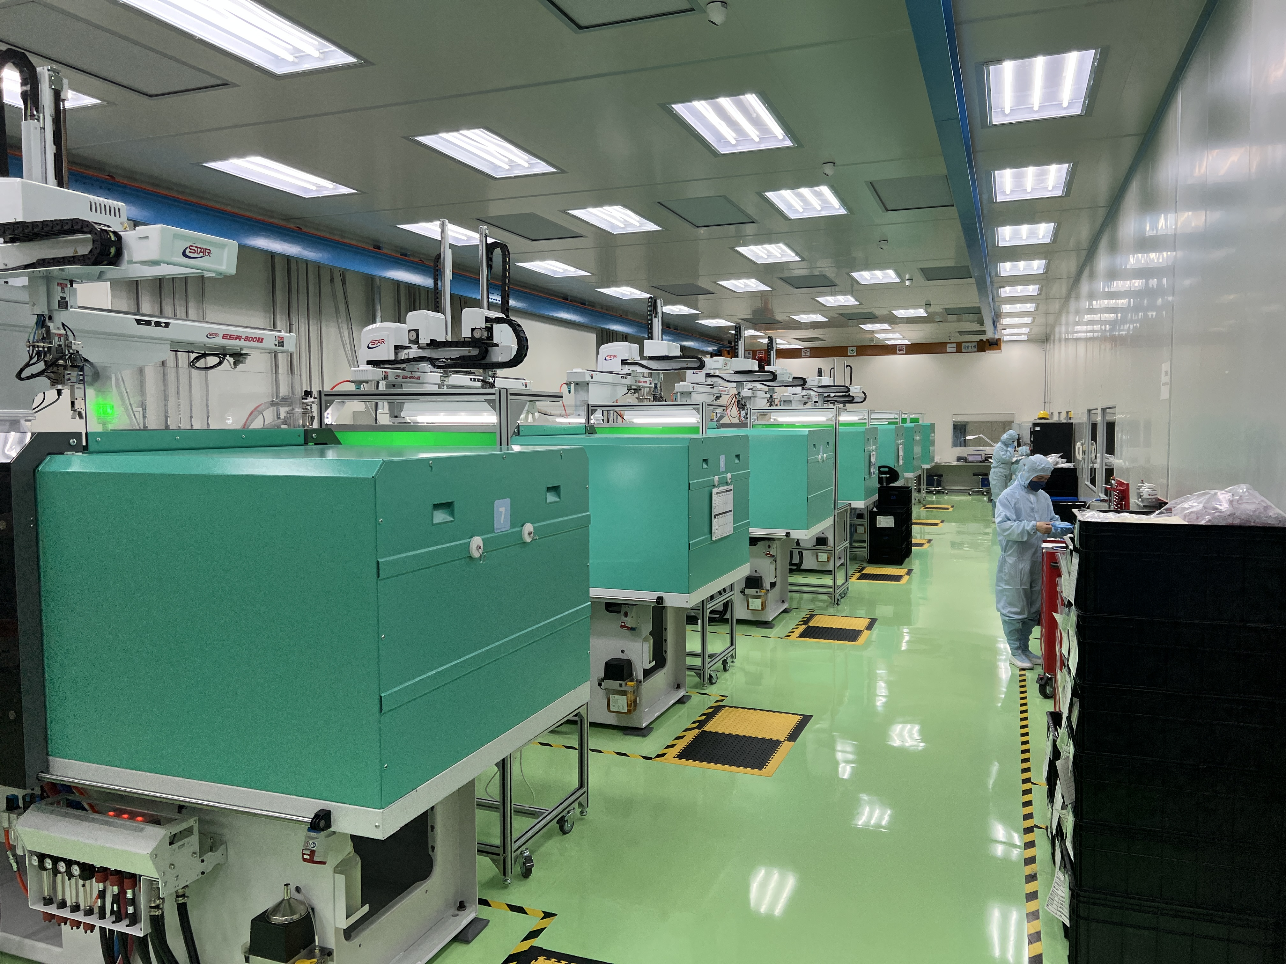
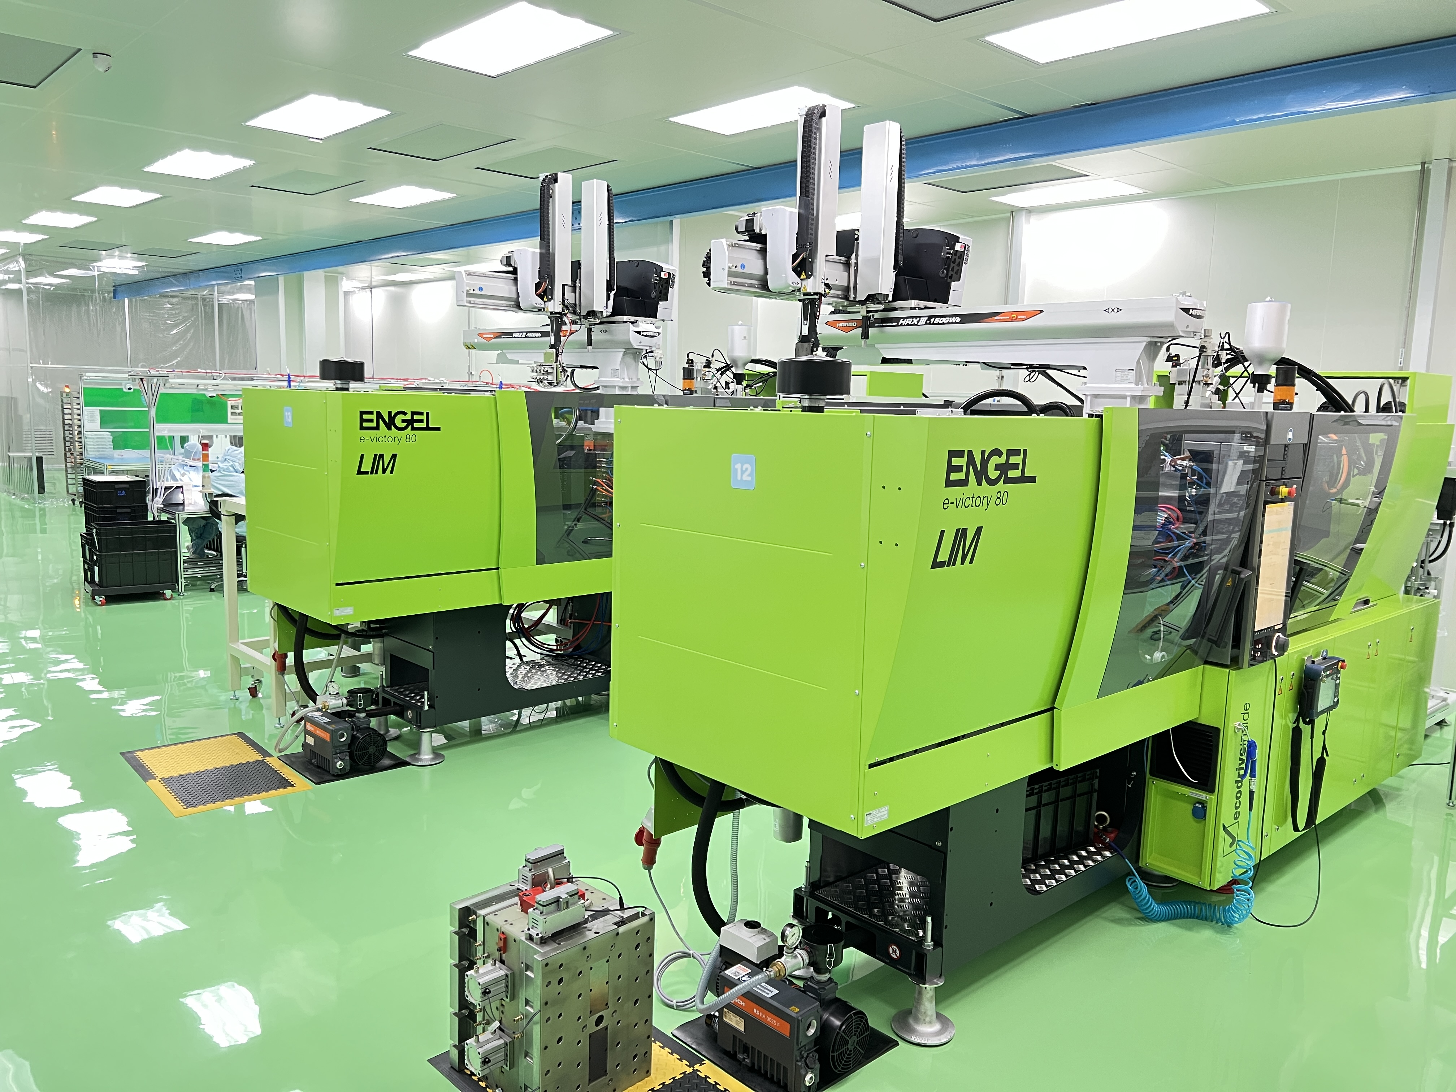
PRODUCTIVITY - Cleanroom Molding Fleet
10 ARBURG Injection Molding Machine
100 Ton – 7 Machines
200 Ton – 3 Machines
1 Multiplas Vertical Injection Molding Machine
55 tons – 1 Machines
2 ENGEL – E-Victory 170/80 PRO LSR Molding Machine
80 Ton Injection Machine – 2 Machines
10 STAR & HARMO Machine Arms
Machine Arms Pair With 100 Ton Injection Machine – 7
Machine Arms Pair With 200 Ton Injection Machine – 3
Cleanroom Automatic Material Transfer System
| 04
Copyright ©2024 Pyramids Technology Corp. All rights reserved

Slide 6
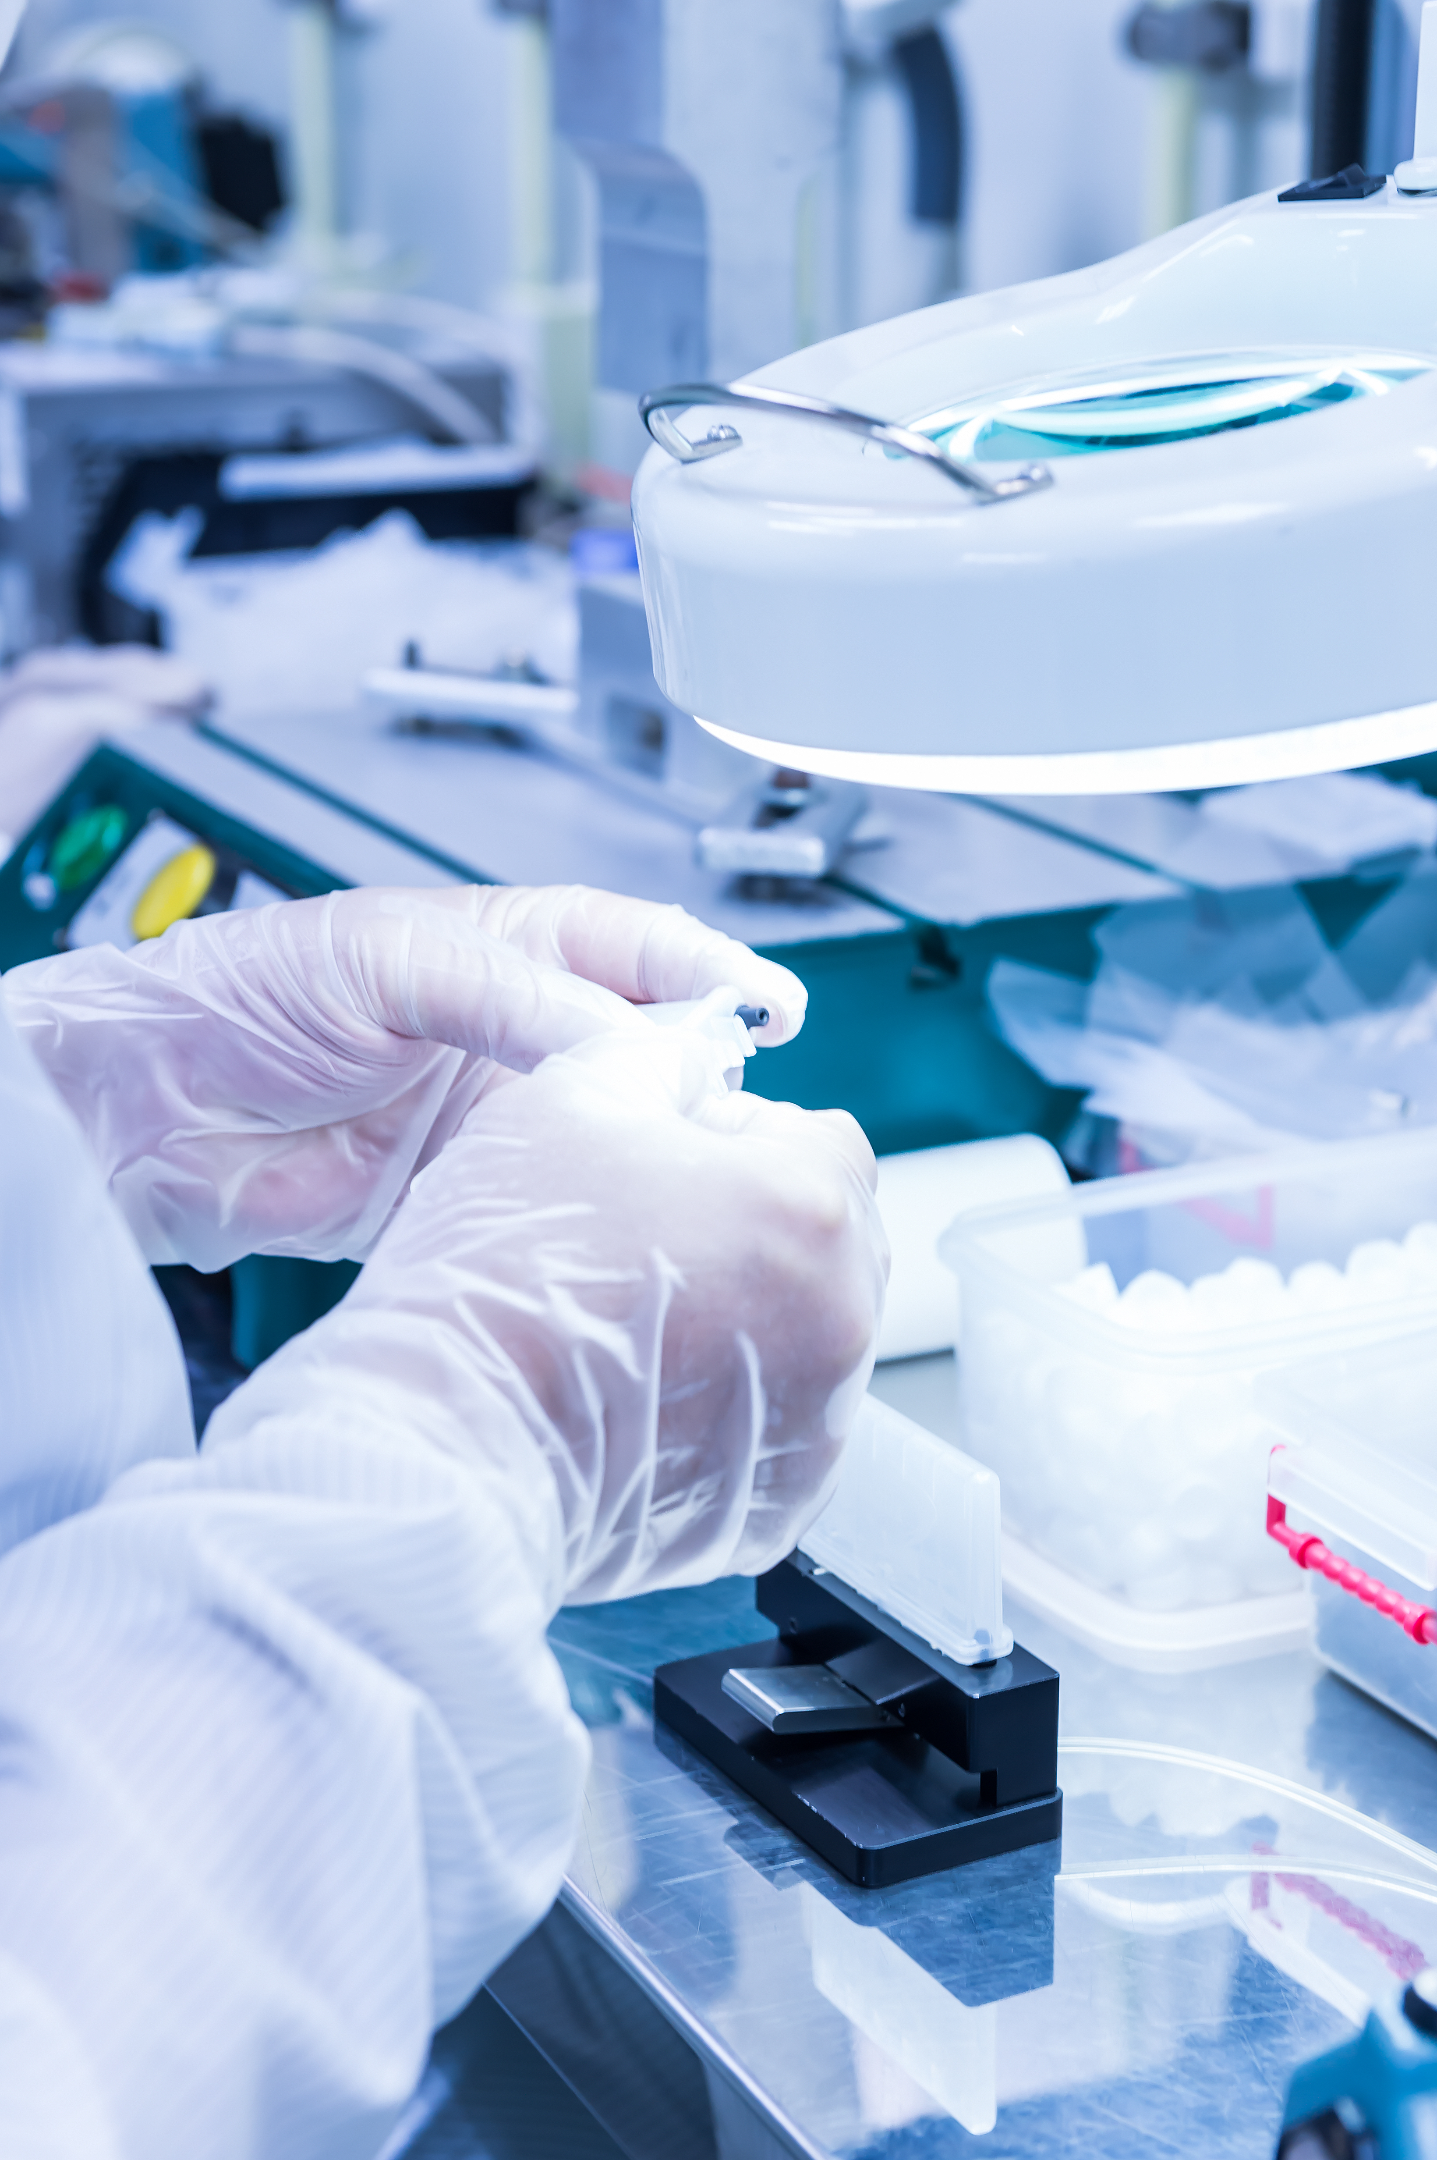
PRODUCTIVITY
ISO Level 7 Cleanroom Assembly Facility
Cleanroom Assembly Facility Area – 5700 sq ft
Cleanroom Assembly Rooms – 4 Rooms
Cleanroom Assembly Lines – 27 Lines
Cleanroom operators – 60 Operators
Upcoming 2025 expansion plan
| 05
Copyright ©2024 Pyramids Technology Corp. All rights reserved

Slide 7
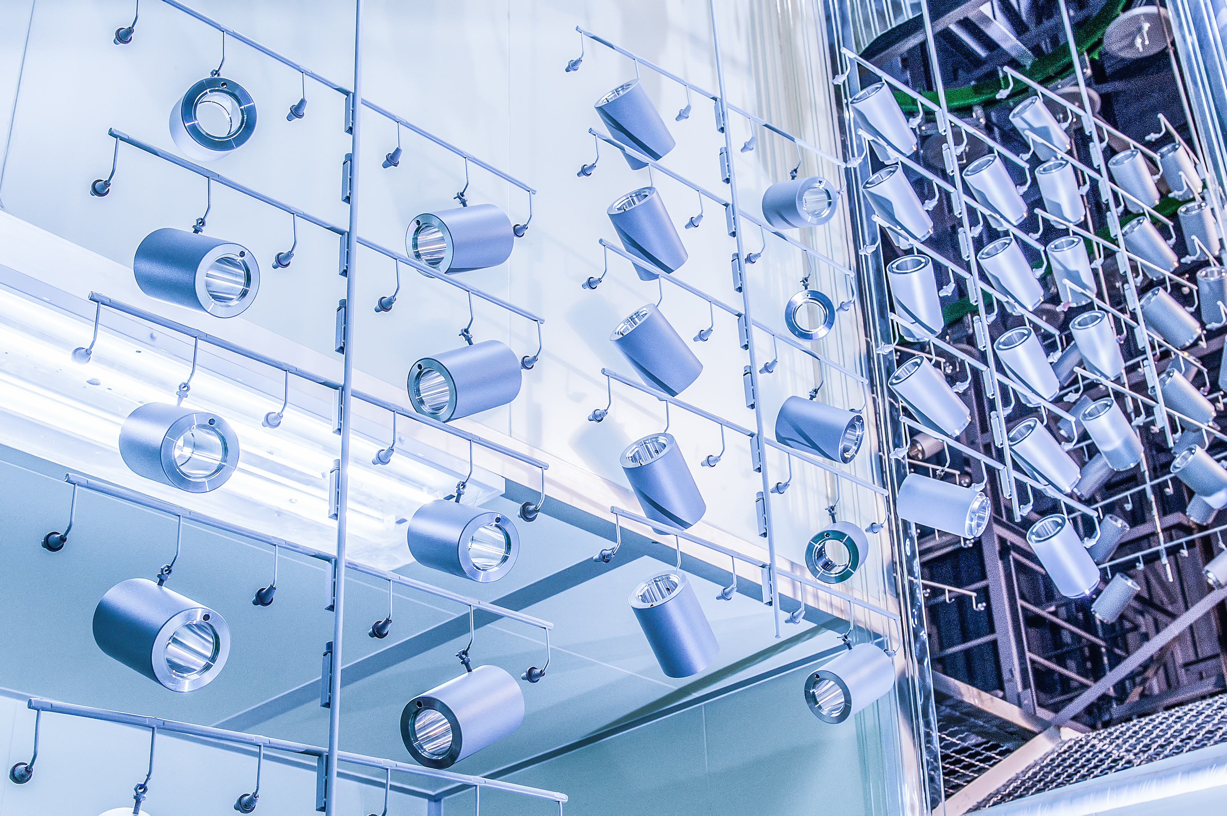
PRODUCTIVITY – Powder Coating Plant
PPC Facility Area: 29,000 sq ft
PPC Operators: 40 Operators
Powder coating Engineers: 6 Engineers
Preparatory Line: 3 Lines
Mian Line: 1 Line
Spray Booths: 2
Paint Stripping Room: 1
Pre-treatment / Sewage Treatment system
(136) 啟鑫粉體塗裝廠 Pyramids Powder Coating Plant (PPC) - YouTube
| 06
Copyright ©2024 Pyramids Technology Corp. All rights reserved

Slide 8
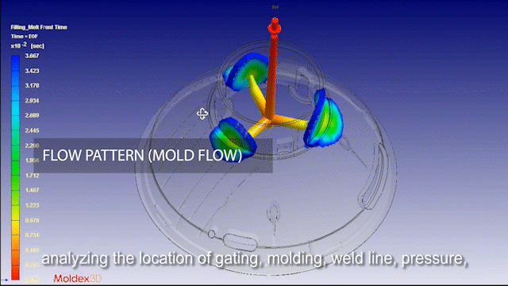
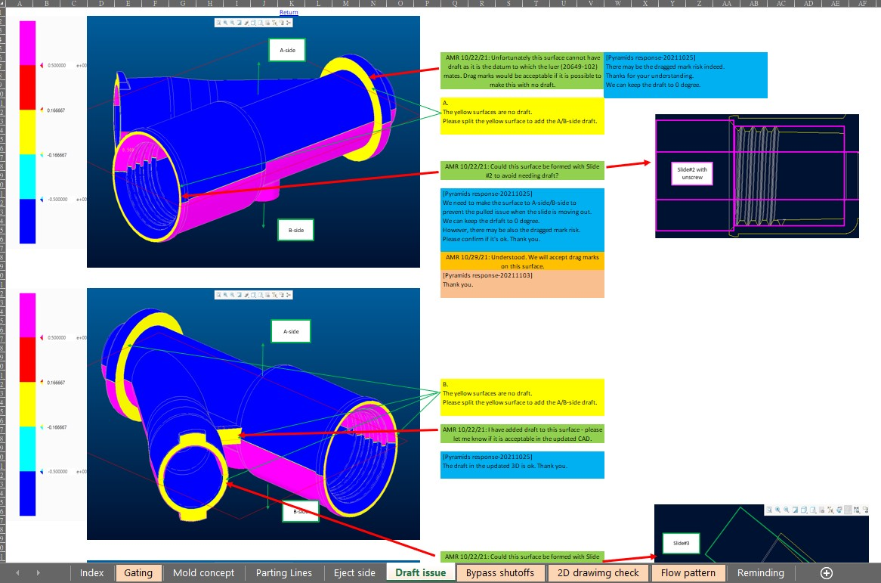
ENGINEERING – DFM Analysis
Product Analysis
Optimize Product design
Potential defect Improvement
Mitigate Potential Risks
Mold Development
Decrease Complexity
Enhance Mold Lifespan
Molding Production
Smooth Transition From Trial to Production
Quality Standards
Benchmark For Customer Acceptance and Internal QC
| 07
Copyright ©2024 Pyramids Technology Corp. All rights reserved

Slide 9
ENGINEERING - Risk Analysis &
Medical device manufacturing validation
PPAP
CPK
PFMEA
3Q (IQ, OQ, PQ)
Control Plan (IQC, IPQC, FQC)
DMR (Device Master Record)
| 08
Copyright ©2024 Pyramids Technology Corp. All rights reserved

Slide 10
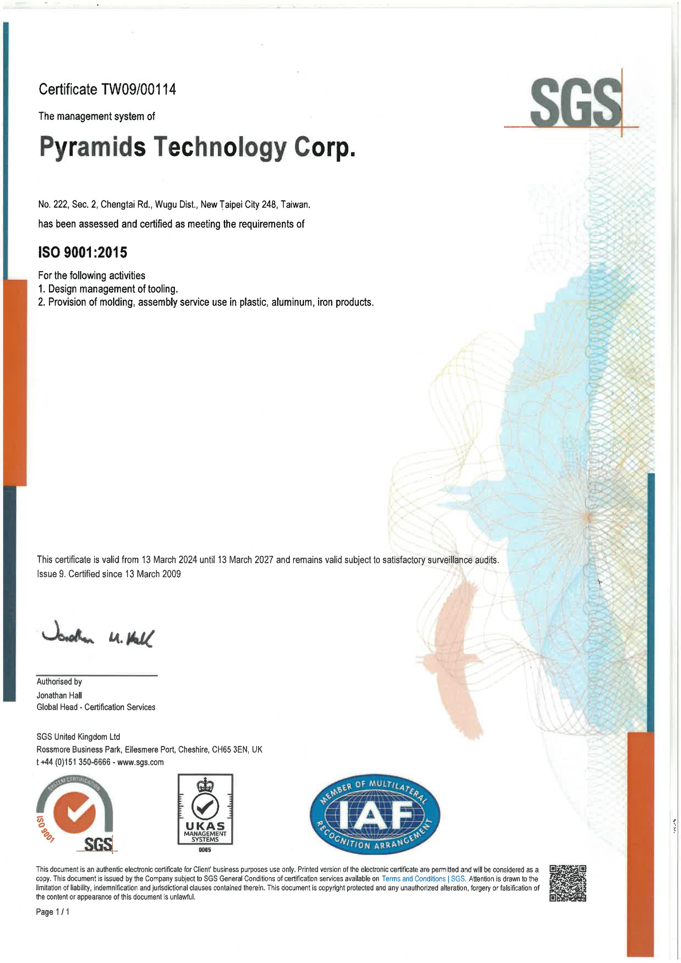
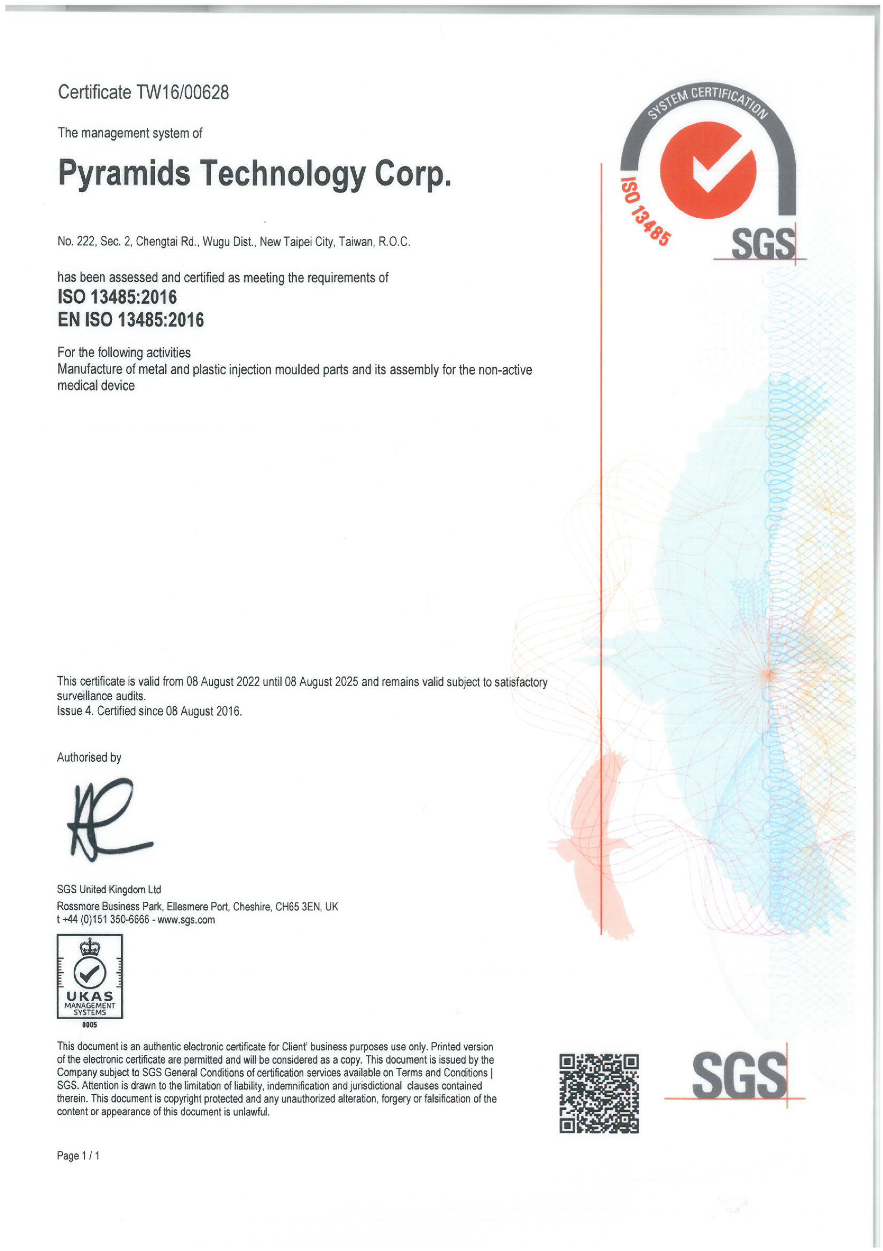
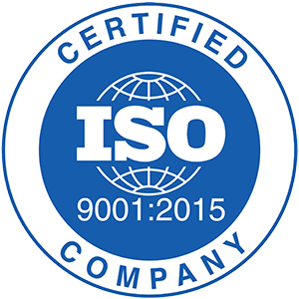
QUALITY – ISO Status & Recent Inspections
Last annual surveillance audits date:
○ ISO 9001: 13 March 2024 (valid from 13 March 2024 until 13 March 2027)
○ ISO 13485: 06 June 2024 (valid from 08 August 2022 until 08 August 2025)
| 09
Copyright ©2024 Pyramids Technology Corp. All rights reserved

Slide 11
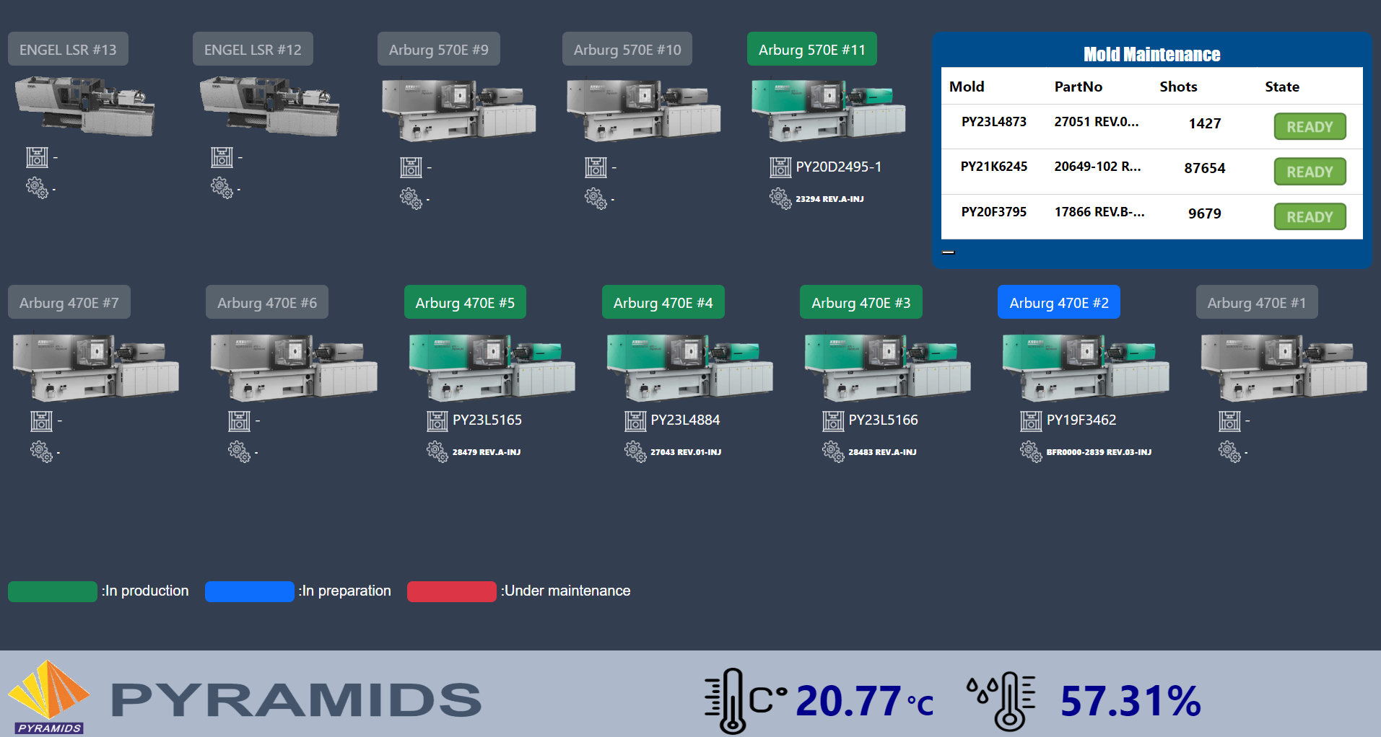
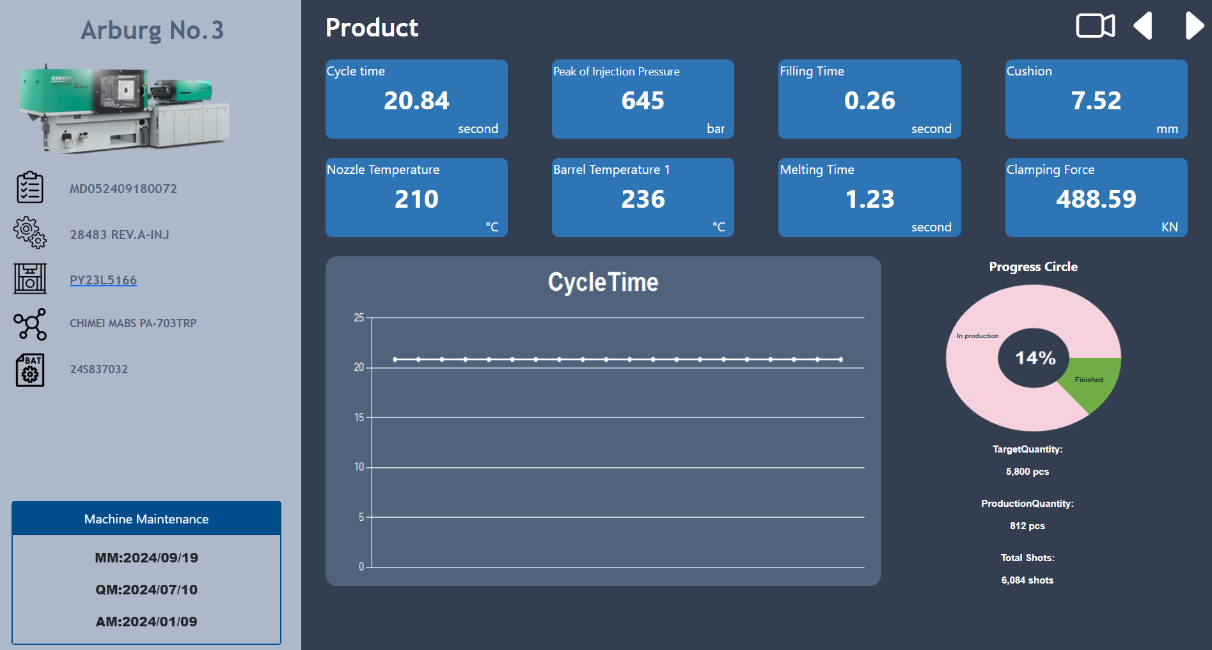
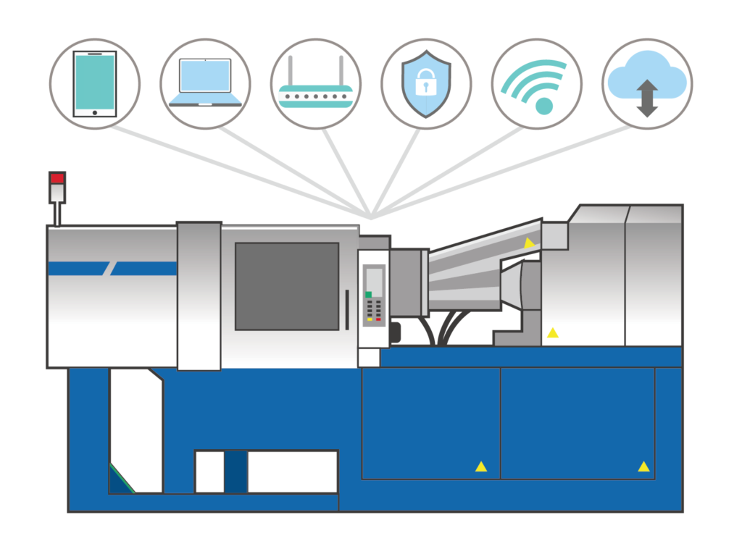
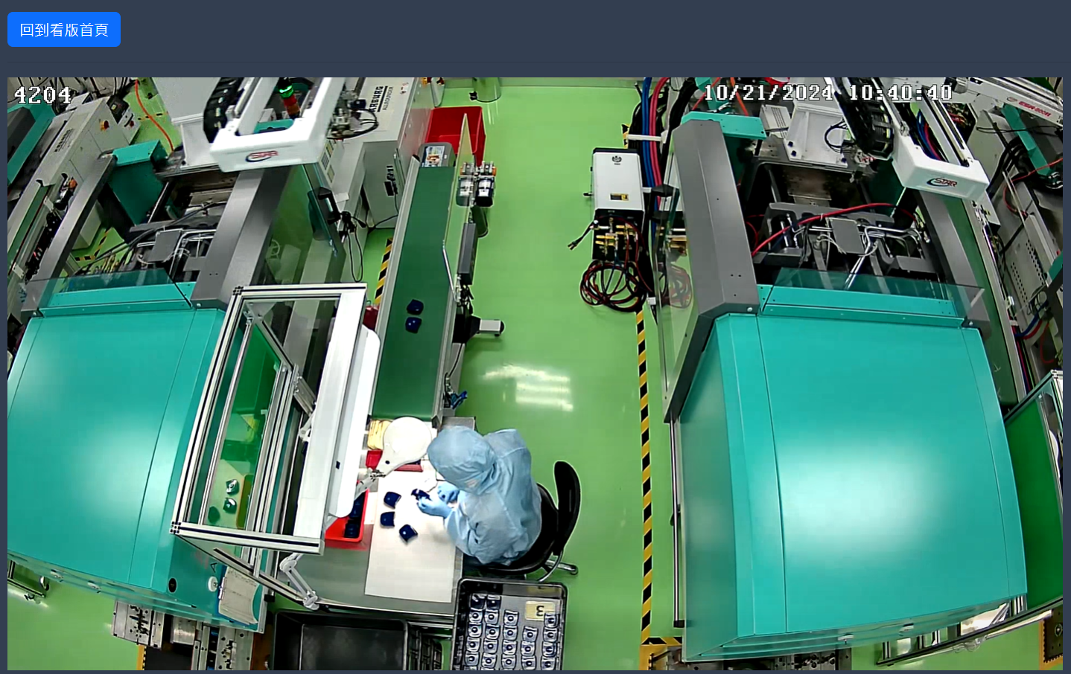
QUALITY - Real-Time CER Machines & Tool Status
Intelligent factory
AIoM injection machine networking system to provide machine management, process monitoring, process history. In time alerts via app message to notify molding process variations.
Pyramids Advanced Molding Department has developed a dedicated website managing the status of all CER machines and tooling
| 10
Copyright ©2024 Pyramids Technology Corp. All rights reserved

Slide 12
Other Manufacturing Process That We Do
Metal Service:
Aluminum Extrusion
Die Casting Aluminum, Magnesium, Zinc
Sand Cast- Conventionally and Automated
Cavity & Investment Casting
Stamping & Sheet Metal
Four Slide and Progressive die production (Stamping)
MIM (Metal Injection Molding)
CNC (Precision Machining)
Powdered Metallurgy
Tube Bending
and more…
LSR Service:
In House Primer application
Cleanroom Production Environment
and more…
Other Services:
Wire Forming
Laser cutting/ engraving
and more…
Plastic Service:
Compression Molding
Injection Molding – Cleanroom / Non-Cleanroom Environment
Vacuum Forming
and more…
| 11
Copyright ©2024 Pyramids Technology Corp. All rights reserved

Slide 13
Contact Us
Your Reliable Medical Contract Manufacturer
E-mail: info@pyramids.com.tw
Website: https://www.pyramids-tw.com/
Phone: +886-2-8292-3286
Address: No. 222, Sec. 2, Chengtai Rd. Wugu Dist. New Taipei City 248, Taiwan, R.O.C.

